Slide 1
ITAC REVIEW
IAC Build and Deploy Implementation
Project PPM # 203649
Arun Kumar. S
07/17/2017
ITAC Presentation Template: Version Apr2017

Slide 2
Prior ITAC Presentations, Timelines, and Funding
Has project/proposal been previously reviewed at ITAC?
If yes, list below (replacing sample entries):
Type of ITAC approval requested for this presentation
Design Review
Anticipated Project Timelines
Current Phase of Project : Define
Estimated Implementation Date : 12 / 18 / 2017
Funding
Has Project Received AR Funding?: Yes
Initial AR target date: TBD
Additional AR target date (if relevant):
Type of Review | Date | Result (approved / not approved)
ITAC Presentation Template: Version Apr2017

Slide 3
Business Objective
Project Objective:
The Infrastructure as Code (IaC) Build and Deploy Implementation Project will automate bank-approved Windows and Linux Virtual Machine (VM) Operating System (OS) image build, test, and VM provisioning tasks. Software automation tools will be used to enable the aforementioned tasks to be performed quickly, efficiently, and as hands-off as possible.
Reason Project Being Undertaken Now:
In order to consume services from other Phase 1 Projects of the Cloud Program, Private Cloud Compute (PPM Project #203734) and AWS VPC Innovation Lab Implementation (PPM Project #203390) projects, a flexible infrastructure automation or orchestration capability is required.
Anticipated Technical Outcome/Benefit (If Appropriate):
1. Introduce IaC practice to 5/3 through the Hybrid Cloud Program
2. Decrease the length of the VM request and provisioning process
3. Enable agility for business to adopt alternate stack technologies such as Jboss
IT Policies or Standard deviations:
None
ITAC Presentation Template: Version Apr2017

Slide 4



Business Conceptual Design - IAC
IT Infrastructure consumer / user
Notify provisioning status
check-in
check-out
Enterprise SCM tool
IT Infrastructure
Automation
Engineer
ITSM
Service Catalog
Service Request
Management
Peer code
Review
& approval
Build / Orchestration
tool
Build Pipeline /
Orchestration Workflow
Stage 1
Stage 2
Stage n
Integration Plug-ins / Code
Notify build / test
outcome
AWS Cloud Resources
(Compute, Storage, Network, User accounts etc.)
Vmware Cloud Resources
(Compute, Storage, DNS)

Slide 5















Business Conceptual Design - IAC
Prod
Stg
Test
Validate
QA
Dev
Build
Enterprise
Repository
Approver
Infra Code Developer

Slide 6
Project Name, Project Sponsors, Key Members
Project Name: Infrastructure as Code – Build and Deploy
Project Sponsors: Jerry Frederick
Key Project Members: Mike Linville, Josh Gooch, Randall Gray, Brad Chamberlain/Joe Pizza, JP Srinivas, Stacey Johnston, Robert (Bob) Dove/Gary Lane, Karen Carr, Michele McDonel, Dave Isenhower, Ranbir Singh, Donald Knox, Jim Harding/Eric Tucker
ITAC Presentation Template: Version Apr2017

Slide 7
IT Involvement To Date
List NPI Risk Rating: TBD
Enterprise Risk Advisor: TBD
Sourcing: Greg, Beck
IT Risk Advisor: Joshua, Gooch
IS Architect: Ramon, Garcia Pinal
Enterprise Architect: J.P. Srinivas
DR & Business Continuity Planning: Darren, Sliwinski
Enterprise Data Management:
Shared Services: Karen, Carr
QA Testing : Eric, Tucker
IT Operations : Michele, McDonel
ITAC Presentation Template: Version Apr2017

Slide 8
Architecture Decisions
Subject Area | Platform | Topic | Infrastructure-as-code
Architecture Decision | To introduce Infrastructure as a code capability
Problem statement & Requirements | Infrastructure changes should be version controlled and documented Should be able to store and retrieve infrastructure state information Should be able to trigger infrastructure provisioning from application build and deploy pipeline
Assumptions | GIT server will be deployed in 5/3 as the Enterprise source code management tool Jenkins will be deployed as a build tool for enabling orchestration On-premises compute Service provisioning and off-premises (AWS) hosting service will be managed through the Infrastructure-as-code platform, and will be requested through Remedy
Alternatives evaluated | Infrastructure Automation
Justification | While Infrastructure automation solution cater to provisioning / orchestration and automation, they do not maintain information about the provisioned resources for on-going management Infrastructure automation solution document and version control the changes made to the provisioned resources Infrastructure automation solution provides API , which allows remote trigger/execution of orchestration workflows. However the Infrastructure provisioning code is not exposed through the API, and hence limit the possibility of modifying infrastructure provisioning , as part of application build / deploy pipeline
Implications
Derived Requirements (if any) | Version Control System / Workflow / Repository
Related Decisions
ITAC Presentation Template: Version Apr2017

Slide 9
Architecture Decisions
Subject Area | Management | Topic | Terraform
Architecture Decision | To use Terraform to deploy/provision and maintain infrastructure (as code) in both AWS and Vmware environment
Problem statement & Requirements | Provision infrastructure across multiple technology platforms, from a single source configuration Package infrastructure code as a reusable artifact, which can be integrated with continuous delivery pipeline Require ability to validate changes (for impact) prior to promoting changes to already provisioned infrastructure Require ability to rollback changes made to provisioned environment, in case of failure Maintain state information of the provisioned infrastructure
Assumptions | Terraform enterprise suite will be used for Implementation OS image build and test will be performed by Terraform enterprise ( in conjunction with Packer) Terraform will be integrated with Jenkins for orchestration of provisioning tasks
Alternatives evaluated | Chef Puppet
Justification | Open source Cloud Agnostic automation framework Native integration with Packer (image build tool) Maintains state information of provisioned infrastructure Dry-run capability to test Infrastructure changes for impact, prior to executing those changes
Implications
Derived Requirements (if any)
Related Decisions
ITAC Presentation Template: Version Apr2017

Slide 10
Architecture Decisions
Subject Area | Management | Topic | Terraform
Architecture Decision | To use Terraform Community edition to start with and later migrate to Enterprise edition
Problem statement & Requirements | Terraform enterprise private install can only be done on AWS VPC AWS VPC is not production ready to facilitate Terraform Enterprise edition
Assumptions
Alternatives evaluated
Justification | Community Edition will be supported by Hashicorp within their existing MSA
Implications
Derived Requirements (if any)
Related Decisions
ITAC Presentation Template: Version Apr2017

Slide 11
Architecture Decisions
Subject Area | Management | Topic | Packer
Architecture Decision | To use packer to build OS images for multiple technology platforms (AWS, Vmware)
Problem statement & Requirements | Build images for multiple platform (AWS, Vmware) from a single source configuration file To use packer for both Windows and Linux OS image build To use packer for updating OS images
Assumptions | Vendor provided OS images (Vanilla OS images) will be used as source Packer will be used to build a target image from the source, by applying Fifth third Bank specific policies Image build for Vmware will be performed in the Vmware environment, and image build for AWS will be performed in AWS Images will be stored in image repository, and relevant Metadata will be associated with the image
Alternatives evaluated | SCCM for Windows VMs Kiwi for Linux AMI’s for AWS Templates for VMware
Justification | Ease of use Packer can build images for multiple technology platforms, from a single configuration file Packer has native integration with Terraform for Infrastructure provisioning
Implications
Derived Requirements (if any)
Related Decisions
ITAC Presentation Template: Version Apr2017

Slide 12
Architecture Decisions
Subject Area | Management | Topic | Test Automation
Architecture Decision | To perform automated testing of provisioned cloud resources (servers), instead of manual checklist based validation To publish test reports to relevant stakeholders
Problem statement & Requirements | Validation of provisioned servers is currently manual and involves hand-offs between multiple teams to check and signoff the provisioned resources There are no documented records of the checks that were performed and the outcome Hence the requirement to automate the validation of provisioned resources
Assumptions | The necessary tools for Test automation will be made available The current checklist in use will be quantified into tangible test cases with help from Infra. engineering and QA teams InfoSec compliance checks will be part of the test automation framework Test automation / Infrastructure validation is a one-time activity that will be performed as part of provisioning process. Continuous configuration management / validation is an operational activity, and is considered out of scope of the test automation framework
Alternatives evaluated | Validation through continuous configuration management tool
Justification | Continuous configuration management capability is currently not available , and hence is not considered Continuous configuration management is considered as a day-2 operations activity, and hence is not considered as part of provisioning (Day-1 activity)
Implications
Derived Requirements (if any) | The test automation framework can be extended for InfoSec compliance validation automation (as an operational task)
Related Decisions | Sys Arc – Policies, Requirements & Test Cases
ITAC Presentation Template: Version Apr2017

Slide 13
Architecture Decisions
Subject Area | Management | Topic | Compute / Private
Architecture Decision | To provide Redhat enterprise linux VM as a compute service offering on-premises To provide Windows 2012 R2 standard VM as a compute service offering on-premises To provide Jboss middleware platform (Jboss web server, Jboss EAP) as a service offering on-premises To not offer self-service automated provisioning of Storage and network resources on-premises
Problem statement & Requirements | Automated self-service provisioning of compute resources Manual provisioning of storage and network resources
Assumptions | Self service automated provisioning is considered only for the compute platform The capability will be extended to storage and network resources, post implementation of software defined storage and software defined networking platforms Self service provisioning will be extended to other middleware platforms (e.g., PostgreSQL) on need basis
Alternatives evaluated
Justification
Implications
Derived Requirements (if any) | Continuous configuration management is required for post provisioning validation and enforcement of configuration standards, and for automation of post provisioning tasks
Related Decisions | Audit / Security [capability can be looked into] Devops Adoption Standardization / Security Policies
ITAC Presentation Template: Version Apr2017

Slide 14
Architecture Decisions
Subject Area | Management | Topic | Compute, Storage, Network / AWS
Architecture Decision | To provide self-service automated provisioning of compute, storage and network resources off-premises (AWS)
Problem statement & Requirements | Automated self service provisioning of compute, storage and network resources off-premises (AWS)
Assumptions | Compute, storage and network resource provisioning is considered to be in scope of the current project Self-service provisioning of all other resource types will be taken up on need-basis / considered for phase 2 of IAC build and deploy project
Alternatives evaluated
Justification
Implications
Derived Requirements (if any) | Continuous configuration management is required for post provisioning validation and enforcement of configuration standards, and for automation of post provisioning tasks
Related Decisions | Audit / Security [capability can be looked into] Devops Adoption Standardization / Security Policies
ITAC Presentation Template: Version Apr2017

Slide 15
Architecture Decisions
Subject Area | Management | Topic | Image Management – Federated
Architecture Decision | To centralize image build for on-premises and off-premises To federate image storage and administration
Problem statement & Requirements | Image build to be centralized to ensure consistency across on-premises and off-premises Image storage and administration to be decentralized, to ensure quick provisioning
Assumptions | Image build be performed on-premises Image will be stored for consumption locally, in each datacenter (floky and Grami), and also off-premises , to reduce the time taken to provision resources using the golden image
Alternatives evaluated | Centralized image build and storage
Justification | Copying images over WAN link across datacenters and off-premises cloud region will be expensive and time-consuming Since images are built from single source / configuration, image consistency is guaranteed, and hence negates the need for a centralized image storage
Implications
Derived Requirements (if any)
Related Decisions
ITAC Presentation Template: Version Apr2017

Slide 16
Architecture Decisions
Subject Area | Management | Topic | Artifact being save outside
Architecture Decision | DR is not required for the automation platform
Problem statement & Requirements | To ensure protection for the automation platform resources
Assumptions | The automation platform configuration can be exported into files which are stored off-site via current enterprise backup platform In an untoward event, the configuration can be restored from the backed up configuration files The state information of the provisioned resources is also maintained by the automation platform in a file format, and hence will be backed up and protected
Alternatives evaluated
Justification | The RTO planned for the automation platform is 72 hours, which is a good enough window for invoking standard backup and recovery procedures for recovering the automation platform from failure, to previous known good state
Implications
Derived Requirements (if any)
Related Decisions
ITAC Presentation Template: Version Apr2017

Slide 17
Non Functional / operational Requirements
Capture all relevant operational requirements
Index | Requirement Name | Value(s)
NFR01 | Only pre-approved service offerings will be published in the service catalog
NFR02 | Service request for new infrastructure provisioning (i.e., those published in the service catalog) will not be subject to ITAC / ITSSCA approval, and will be provisioned directly
NFR03 | The DR / High availability capability provided by the underlying virtualization environment will be leveraged for Infrastructure-as-code automation platform
NFR04
NFR05
NFR06
ITAC Presentation Template: Version Apr2017

Slide 18
Checklist – Capacity Planning & Management
Item
Will long term transaction history require additional disk storage? | N/A
What are the product dependencies i.e. database - web presentation - Unix - Mainframe? | N/A
Is it possible to monitor and record application resource utilization? | Y
What is the expected 1st year growth of the product? | Minimal
What is the means for storing archived data and how will data be restored? | N/A
Can the test environment be scaled down and still accomplish adequate testing? | Y
What resources are required for development? | Virtual servers
Is the current work load monitored today for vendor recommendation comparison? | N/A
Has the vendor produced performance statistics from a like sized environment if the product is new to our business? | N/A
What are the product specifications for performance analysis on CPU, Memory, Disk and I/O utilization? | N/A
Can the product function in a shared VMWare environment? | Y
Is the product expandable/scaleable up and down for business expansion and contraction? | Y
Does the solution uses / has any open source technologies (libraries, tools, platforms etc) | Y
ITAC Presentation Template: Version Apr2017

Slide 19
Technology Stack - Automation
Cloud Provider
AWS/VMware
Infrastructure Provisioning
Terraform
Image Build
Packer
ITAC Presentation Template: Version Apr2017

Slide 20
Technical Views
IAC – overview and Benefits
IAC – Methodology
IAC – CI/CD Integration
OS Image build / Pre-provisioning process
New image build process
Image update process
Image management & maturity model
IAC – Build and test workflow
IAC – Provisioning (Roadmap)

Slide 21
Infrastructure as a Code
Why Infrastructure as Code instead of Infrastructure Automation ?
Infrastructure automation can take repeatable actions and enact them across any number of servers, but Infrastructure as Code includes tools and capabilities from the software development world to build, maintain, and test those actions in a more manageable way.
Embracing IAC for enterprise is key to achieve
Enabling infrastructure code in the software development lifecycle by putting it through build, testing/QA, and production along with application code.
Start with and maintain a simple design for the infrastructure code and any new features. Supporting to develop design patterns.
Institute code reviews with the help of team notifications for each commit. Pair programming is also helpful.
Maintain a shared set of coding standards for the infrastructure code.
Continuously test with as many of the same styles of development testing that could be applicable to Infrastructure as Code. This ensures that the code definitions produce the correct environments and don’t introduce problems.
Employ infrastructure monitoring for testing and pre-production environments as well as the production environment.
Refactor the infrastructure code to reduce the amount of maintenance needed.

Slide 22
Infrastructure as a Code
Infrastructure as code (IaC – Build & Provisioning) is the process / methodology of managing and provisioning computer infrastructure through machine-readable definition files.
Pre-Provisioning & Provisioning Process
Infrastructure as code (IaC – Configuration Management) is the process of ensuring that the current design and build state of a specific system is known, good & trusted; and doesn’t rely on the tacit knowledge of the development or operations team
This methodology can further be integrated to various Infrastructure automation workflows as business cases evolve.
Post Provisioning process
Factors being looked for Infrastructure as code (IaC – Build & Provisioning) adoption
Automation Level
Template Library
Support Structure
Portability
Modular, reusable components
Simple Declarative statements to describe the desired state of the systems to be provisioned
Make incremental changes to any individual environment component and deploy those changes to your environment
Identify any incremental changes made to the environment and be able to track the time when the changes were made

Slide 23

Infrastructure as a Code Integration
V 1.1
Infra Pre-provisioning process
[Hashicorp Packer]
OS Image Build across Platforms
Infra Provisioning process
[Hashicorp - Terraform]
Approved Infra Deploy
Continuous Configuration Automation [Ansible / Chef / Puppet]
Post - Provisioning process
Orchestrated Configuration Management
GitHub Enterprise
VSphere + AWS
VSphere + AWS
VSphere + AWS
Source
Control
Build /
Dev & Test
Staging
Production
Every commit pushed to the repo will result in infra being verified and built
Promotion of dev to stage is using the same code + controls to meet the environment needs
Promotion of stage to Prod is using the same code + controls to meet the environment needs

Slide 24
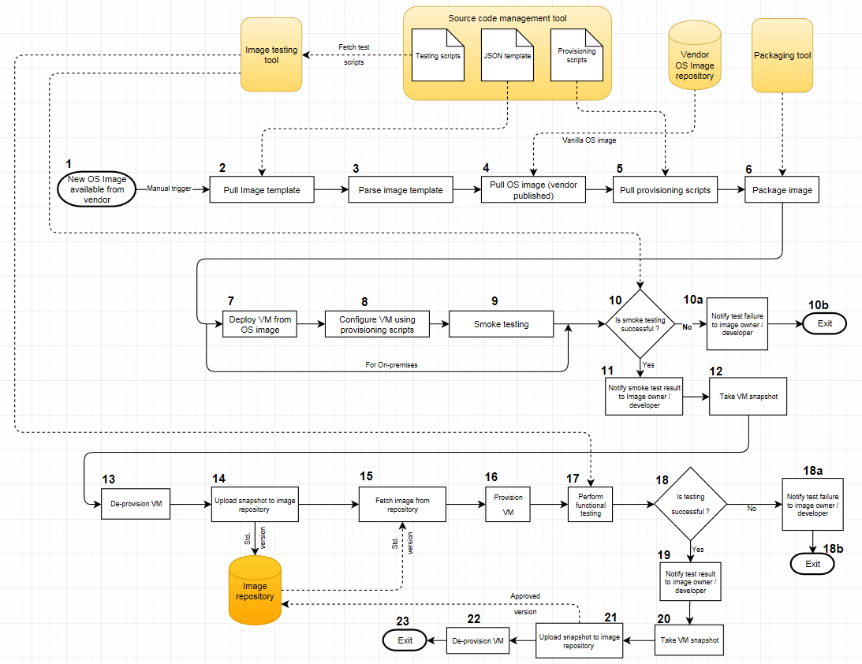
Image build process – Release 1 (when a new OS image is available from vendor)

Slide 25
Image build process – Release 2 (when new standards / policy are published at 5/3)

Slide 26










Hybrid cloud – OS Image Management Model
Dev
QA
Prod
region
Golden
Images
Vanilla
OS, S/W
Images
Private Cloud Environment
Image
Build
Tool
SCM Tool
(Workflows, Scripts
Templates)
VMware Vcenter
VMware Esxi
Golden
Image
Repo

Slide 27
OS Image Adoption – Maturity process

Slide 28
Infrastructure as a code – Build & Test workflow
Infrastructure code (Windows & Linux VM (IaaS) provisioning) is developed by infrastructure automation engineer and uploaded to SCM (Enterprise GIT)
The checked-in code is subject to peer review
Build Tool (e.g., Hashicorp Atlas / Jenkins) monitors SCM changes
SCM update will trigger Build pipeline
Build Tool (e.g., Hashicorp Atlas / Jenkins) fetches Provisioning File from SCM (Enterprise GIT)
Build Tool (e.g., Hashicorp Atlas / Jenkins) provisions VM through provisioning tool (Terraform)
Build Tool (e.g., Hashicorp Atlas / Jenkins) validates VM (smoke testing) through provisioning tool (Terraform)
Testing is performed using pre-defined test scripts
Build Pipeline would invoke Endpoint Configuration Management system (e.g., Puppet Enterprise) for installing platform software on the provisioned VM
Endpoint Configuration Management system (e.g., Puppet Enterprise) would validate platform software install
Build Tool (e.g., Hashicorp Atlas / Jenkins) notifies developer of success or failure
The provisioned VMs are decommissioned

Slide 29
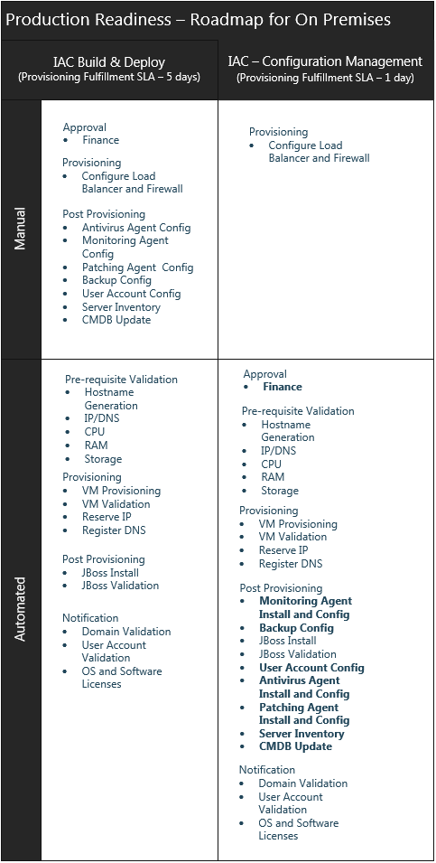
Infrastructure as a code – Provisioning Roadmap (On-Premises)

Slide 30
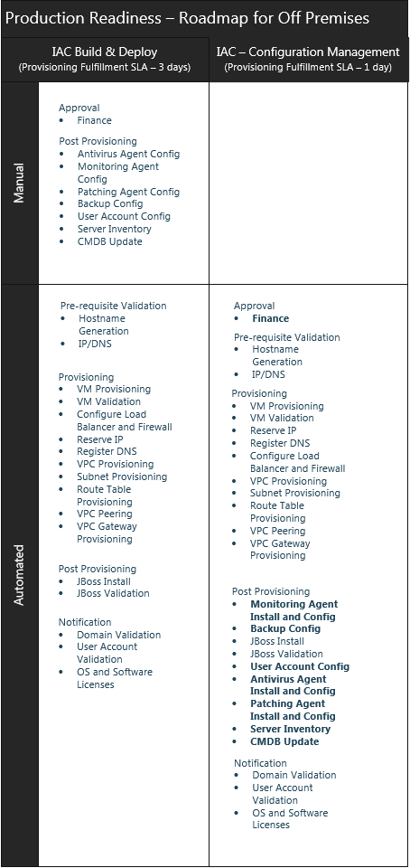
Infrastructure as a code – Provisioning Roadmap (Off-Premises)

Slide 31
Technical Views
DEV environment (Grand Rapids)
Prod environment (Florence)
Terraform
VM
Terraform
VM
Packer
VM
Terraform
VM
Packer
VM
Vmware Virtualization Layer
Vmware Virtualization Layer
Existing Compute Infrastructure
Existing Compute Infrastructure
Non-Replicated SAN Storage
Non-Replicated SAN Storage
New Servers
ITAC Presentation Template: Version Apr2017

Slide 32
New Resource Requirements Summary Replace examples with resources required for this project.
Device and Function | Device Type (Blade, VM, LPAR, etc.) | Qty | # of CPU | # of Gb of RAM | O/S Type (Windows, AIX, Solaris, etc.) & Version | SAN Non-Rep per Server | SAN Replicated per Server | Database (DB2, Oracle, SQL, etc.) & Versions | Environment (Prod, Stage, DR, UAT, Dev, etc.) | Location (FloKY, GRaMI, etc.) | Middleware (IHS, IIS WAS, etc.)
Terraform – VMware Secondary | VM | 1 | 4 | 16 | Linux | 160 |  | N/A | Dev | Grami | N/A
Packer | VM | 1 | 4 | 16 | Linux | 160 |  | N/A | Dev | Grami | N/A
Terraform – VMware Primary | VM | 1 | 4 | 16 | Linux | 160 |  | N/A | Prod | Floky | N/A
Packer | VM | 1 | 4 | 16 | Linux | 160 |  | N/A | Prod | Floky | N/A
Terraform – VMware Secondary | VM | 1 | 4 | 16 | Linux | 160 |  | N/A | DR | Grami | N/A
ITAC Presentation Template: Version Apr2017

Slide 33
Maintenance & Support
Specify Initial and Ongoing Costs (Out to 3 Years)
Consulting
Hardware
Software
Outside Service Provider
Support
New or Existing FTEs? How many?
Existing
Required Skillsets?
Terraform, Packer
Training
Training required on Hashicorp Terraform suite of products
ITAC Presentation Template: Version Apr2017

Slide 34
Appendix

Slide 35
AWS Access Keys
Users will be created using IAM.
What level of access users have will be defined in IAM.
They will then be given Access Keys and Secret Keys that will allow them access to specific VMs and APIs.
If an IAM user loses or forgets his/her Access Key, a new Access Key can be generated.
AWS does not store private keys, and AWS does not let you retrieve Secret Keys.
Temporary Access Keys and Secret Keys can be assigned if needed.
An IAM user can have 2 Access Keys (active or inactive) if necessary.
ITAC Presentation Template: Version Apr2017

Slide 36
VMware Access Control
VMware vCenter Single Sign-On will use Active Directory to authenticate users.
A vCenter Administrator can assign permissions on resources on the vCenter Server object hierarchy.
The VMware Administrator will create new Roles as needed. Roles are a set of privileges that can be assigned to a user or group.
These roles will define which resources and privileges the user/group has access to, such as the right to increase RAM on VMs in a certain resource pool.
Then the vCenter Administrator will assign the user/group to the specified Role.
ITAC Presentation Template: Version Apr2017

Slide 37
Backing Up Terraform State
By default, Terraform stores the state of the terraform infrastructure locally in the terraform.tfstate file
Snapshots will return backups of local terraform.tfstate files
In order to backup the state, Terraform will be configured to store the state file remotely in an S3 bucket.
If needed, the state can always be retrieved from S3.
AWS and On-premises datacenters will each have their own S3 buckets.
Terraform files, packer files, and other code will also be backed up to S3 buckets
ITAC Presentation Template: Version Apr2017

